Slide 1
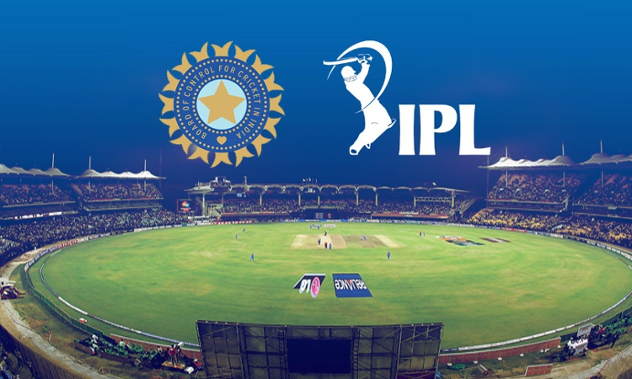
🏏 IPL Player Performance Prediction
Presented by Akshaya Lega
Technologies Used :
Python | Pandas | Scikit-learn | LightGBM | SHAP | Streamlit

Slide 2

Problem Statement
In the Indian Premier League (IPL), player performance varies from match to match due to several factors such as recent form and past performance history.
There is a need for an intelligent system that can:
Predict a player's expected number of runs in an upcoming match
Use historical match and ball-by-ball data
Consider recent performance trends of the player
Provide an explanation for the prediction

Slide 3
Objective of the Project
To design and implement a machine learning based system that:
Predicts the runs scored by an IPL batsman in a match
Uses engineered features from historical IPL data
Applies multiple machine learning models and selects the best model
Explains the prediction using SHAP
Provides an interactive dashboard for users using Streamlit
01
Business overview

Slide 4

Data Collection & Exploratory Data Analysis
The IPL datasets used in this project were .downloaded from Kaggle.
The dataset contains historical Indian Premier League (IPL) match and ball-by-ball data.
deliveries.csv
matches.csv
This file contains ball-by-ball information for every IPL
match.
Main columns:
match_id
batter
bowler
batting_team
bowling_team
runs_off_bat
This file contains match-level information.
Main columns:
id (match id)
season
venue
team1
team2
Loaded both datasets using Pandas
Checked the dataset size (rows and columns)
Inspected column names and data types
Analysed missing values in both datasets
Studied overall data structure using basic statistics

Slide 5
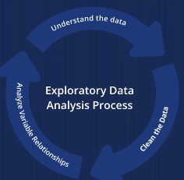
“
EDA
I created multiple visualizations to understand the data:
Number of matches per season
Top 10 venues where matches were played
Toss decision distribution
Top teams by number of wins
Runs scored per ball
Total runs per delivery
Top 10 batsmen based on total runs
Top 10 bowlers based on number of wickets
Outputs generated:
The following graphs were saved:
matches_per_season.png
top_venues.png
toss_decision.png
top_teams.png
runs_per_ball.png
total_runs_per_ball.png
top_batsmen.png
top_bowlers.png

Slide 6
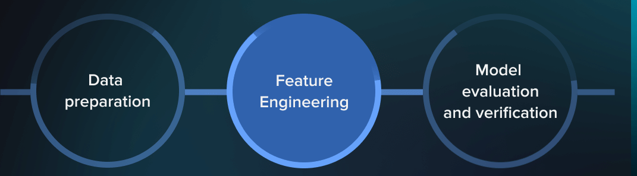
Data Preparation
Merged deliveries.csv and matches.csv using match_id
Converted ball-by-ball data into a player–match level dataset
Calculated total runs and balls per player per match
Created intermediate file → player_match_level.csv
02
Feature Engineering
Market customers
Calculated strike rate
Created matches_played
Computed career average runs (till previous match)
Generated average runs of last 5 matches
Generated average strike rate of last 5 matches
Final feature dataset → batsman_features.csv

Slide 7
Final Feature Dataset Creation
Data Processing:
Loaded the player–match dataset
Sorted data by player and match order
Feature Preparation
Prepared historical performance features:
matches_played
career_avg_runs
avg_runs_last_5
avg_sr_last_5
Data Cleaning
Removed rows with missing feature values
Output
Created final ML dataset : batsman_features.csv

Slide 8
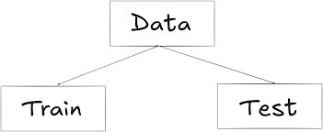
Exploratory Data Analysis & Train–Test Split
Exploratory Analysis
Analysed feature distributions and target (runs)
Visualised main features:
matches_played
avg_runs_last_5
avg_sr_last_5
career_avg_runs
Performed correlation analysis between features and target
Data Preparation for Modeling
Sorted data in match order (time-aware)
Split data into:
Training set (80%)
Testing set (20%)
Output files
train_features.csv
test_features.csv

Slide 9
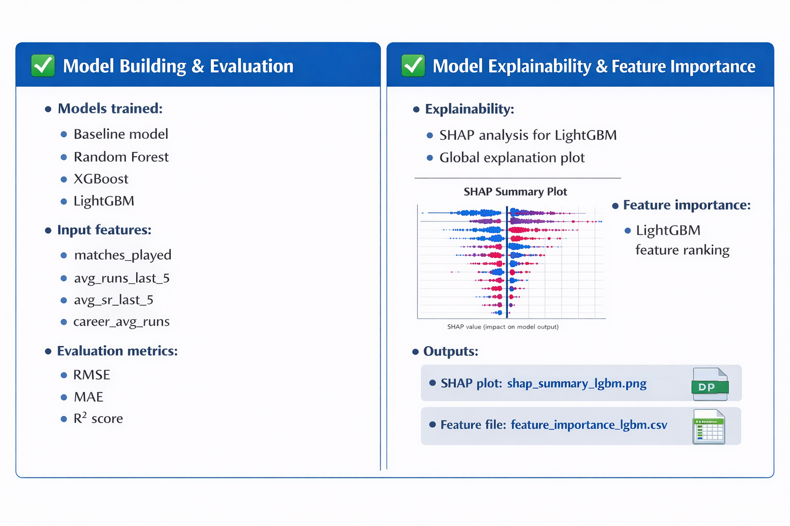
03
Marketing
Sales

Slide 10
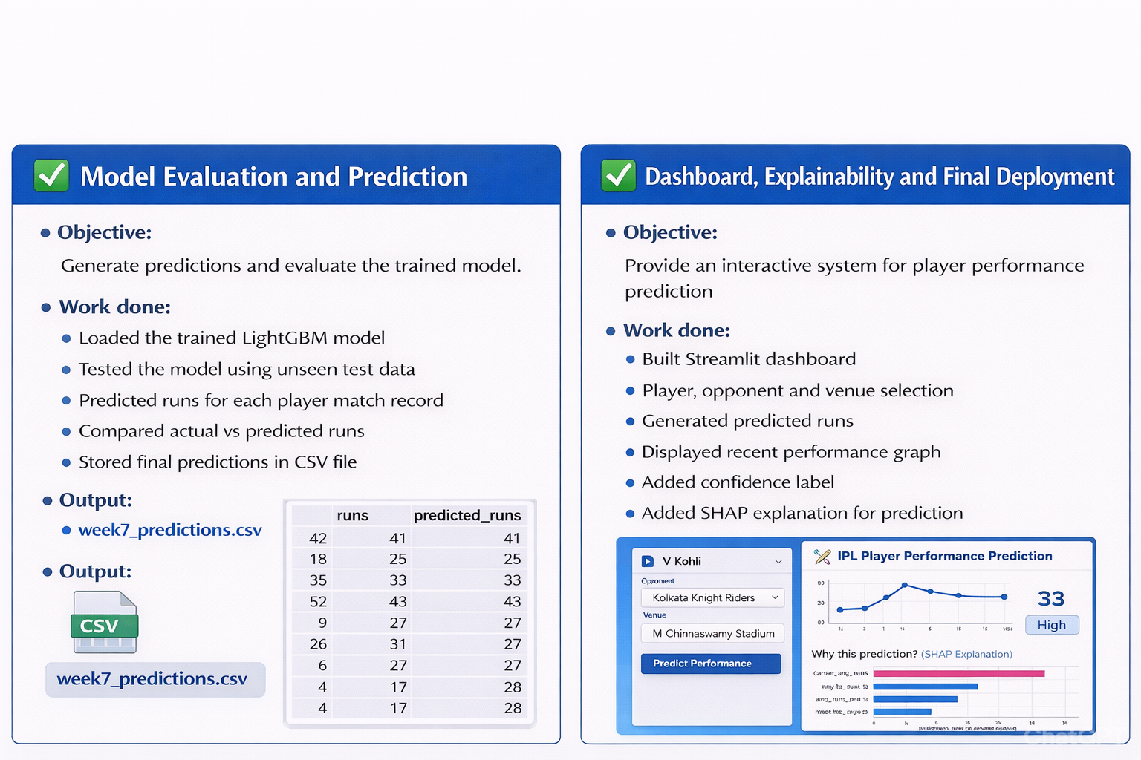

Slide 12
Conclusion
Collected IPL match and ball-by-ball data from Kaggle
Prepared a player-level dataset using data preprocessing
Applied feature engineering using recent and career performance
Built a machine learning model to predict batsman runs
Developed an interactive Streamlit dashboard for visualization and prediction

Slide 13

THANKS

